Slide 1
Organizational Design and Multinational Companies
Multinational Management
耿延

Slide 2
Learning Objectives (1 of 2)
Understand the components of organizational design.
Know the basic building blocks of organization structure.
Understand the structural options for multinational companies.
Know the choices multinationals have in the use of subsidiaries.

Slide 3
Learning Objectives (2 of 2)
See the links between multinational strategies and structures.
Understand the basic mechanisms of organizational coordination and control.
Know how multinational companies use coordination and control mechanisms.
Understand the need for knowledge management systems within organizations.

Slide 4
Organizational Design
The best multinational strategies do not guarantee success. Managers must design their organizations with the best mechanisms to carry out domestic and international strategies.
Organizational Design: How organizations structure subunits and use coordination and control mechanisms to achieve their strategic goals

Slide 5
The Nature of
Organizational Design (1 of 2)
Two basic questions involved in designing an organization:
  How shall we divide the work among the organization’s subunits?
  How shall we coordinate and control the efforts of the units we create?
In small organizations, there is little reason to divide work. Everyone does the same thing and everything

Slide 6
The Nature of
Organizational Design (2 of 2)
As organizations grow, there is a need to divide work into specialized jobs and the organization into specialized subunits.
Once an organization has specialized subunits, managers must develop measures to coordinate and control their efforts.
Decision-making may be centralized or decentralized.
There is no one best organizational design.

Slide 7
The Basic Functional Structure (1 of 2)
In a Functional Structure, departments perform separate business functions such as marketing or manufacturing.
The functional structure is the simplest organization.
Most smaller organizations have functional structures.
Even large organizations have functional subunits.
Organizations choose a functional structure for its efficiency.

Slide 8
The Basic Functional Structure (2 of 2)
Efficiencies arise from economies of scale in each function because of cost savings when a large number of people do the same job in the same location.
Coordination is difficult, as functional units are separated from each other and serve functional goals.
The functional structure works best when the firm has few products, locations, and types of customers.
Works best in a stable environment, with minimal need for adaptation.

Slide 9
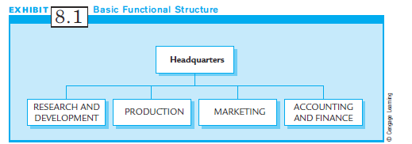
Exhibit 8.1:
A Basic Functional Structure

Slide 10
The Basic Product and Geographic Structures (1 of 2)
Product Structure: Building departments or subunits around a particular product.
Geographic Structure: Building departments or subunits based on a particular geographic region.
Product and Geographic units must still perform all of the functional tasks of a business.
Functional tasks are duplicated for each unit, leading to loss of economies of scale, and loss of efficiency.

Slide 11
The Basic Product and Geographic Structures (2 of 2)
But, such inefficiencies disappear as customer groups and products proliferate.
And even for small organizations, a product or geographic unit may offer competitive advantages:
  It allows a company to serve customer needs that vary by region or product.
  Managers can quickly identify customer needs and adapt products.

Slide 12
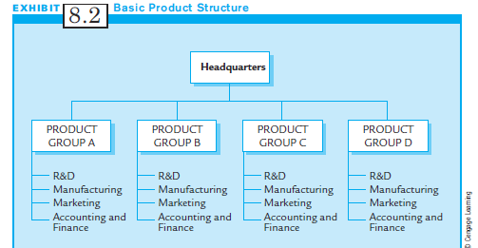
Exhibit 8.2:
Basic Product Structure

Slide 13
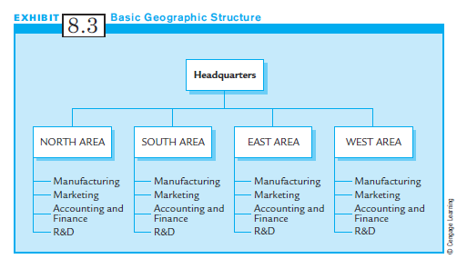
Exhibit 8.3:
Basic Geographic Structure

Slide 14
Hybrid Structures
Few organizations adopt purely organizational forms.
Each organization has unique trade-offs based on efficiency, product types, and customers’ needs.
Companies design organizations with mixtures of structures that will best implement their strategies.
Mixed-form organizations are called Hybrid Structures.
A Hybrid Structure mixes functional, geographic, and product units.

Slide 15
Organizational Structures to Implement
Multinational Strategies
When a company first goes international (as a passive exporter), it seldom changes its structure.
Even though exporting, it prefers to rely on EMCs and ETCs rather than change organizational structure.
Similarly, a licensing strategy has little impact on domestic structure.
However, when international sales become more central, the structure needs to be changed.

Slide 16
The Export Department
The Export Department coordinates and controls a company’s export operations.
The Export department:
  Is created when exports become significant
  Deals with international sales of all products
  Sales representatives in other countries may report to the Export Department manager.

Slide 17
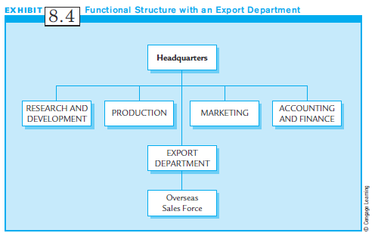
Exhibit 8.4:
A Functional Structure with an Export Department

Slide 18
Foreign Subsidiaries (1 of 3)
Foreign Subsidiaries are subunits of the multinational company that are located in another country
Types of foreign subsidiaries:
  A Minireplica Subsidiary is a scaled down version of the parent firm. It uses the same technology and produces the same products as the parent firm.
  A Transnational Subsidiary supports a multinational firm strategy based on location advantages. It has no firm wide form or function. Each subsidiary contributes what it does best or most efficiently anywhere in the world.

Slide 19
Foreign Subsidiaries (2 of 3)
Most subsidiaries are neither pure minireplicas nor pure transnationals.
Foreign subsidiaries take many forms and have many functions.
Foreign subsidiaries are the structural building blocks for running multinationals.

Slide 20
Foreign Subsidiaries (3 of 3)
Multinationals choose the mix of functions for their foreign subsidiaries based on:
  The firm’s multinational strategy or strategies;
  The subsidiaries’ capabilities and resources;
  The economic and political risk of building and managing a subunit in another country;
  How the subsidiaries fit into the overall multinational organizational structure.

Slide 21
International Division (1 of 3)
The International Division differs from the export department in several ways:
  It is larger and has greater responsibilities.
  It has more extensive staff with international expertise.
  It is responsible for managing exports, international sales, negotiating contracts, and managing foreign subsidiaries.
  It is the usual step after the export department.
  It deals with all products.
  It manages overseas sales force and manufacturing sites.

Slide 22
International Division (2 of 3)
The International Division has declined in popularity among large multinationals.
It is not considered effective for multiproduct companies operating in many countries.
However, for companies of moderate size with limited numbers of products or country locations, the International Division remains a popular and effective structure.

Slide 23
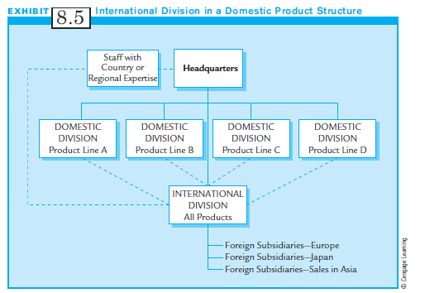
Exhibit 8.5:
International Division in a Domestic Product Structure

Slide 24
International Division (3 of 3)
There are several structural options to deal with the shortcomings of the International Division:
  Worldwide product structure
  Worldwide geographic structure
  Matrix structure
  Transnational network structure

Slide 25
Worldwide
Geographic Structure (1 of 2)
In the Worldwide Geographic Structure, regions or large-market countries become the geographic divisions of the multinational company.
  The primary reason to adopt this structure is to implement a multidomestic or regional strategy.
  Differentiation of products or services requires an organizational design with maximum geographic flexibility.

Slide 26
Worldwide
Geographic Structure (2 of 2)
In the Worldwide Geographic Structure, regions or large-market countries become the geographic divisions of the multinational company.(cont’d)
  The semiautonomous subunits provide flexibility to meet local needs.
  Country-level divisions usually exist only when a country’s market size is sufficiently large to support its own organization.
  Separate divisions make sense for large market countries.

Slide 27
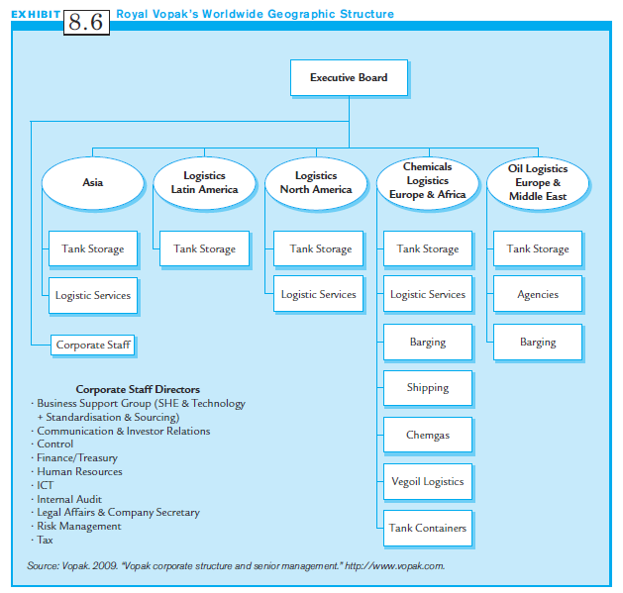
Exhibit 8.6:
Royal Vopak’s Worldwide
Geographic Structure

Slide 28
Worldwide Product Structure
Product divisions form the basic units of the Worldwide Product Structure:
  Each product division is responsible for producing and selling its products or services throughout the world.
  It may be the ideal structure to implement an international strategy in which the firm gains economies of scale by selling worldwide product activities based at home.
  This type of structure sacrifices the regional or local adaptation strengths derived from a geographical structure.

Slide 29
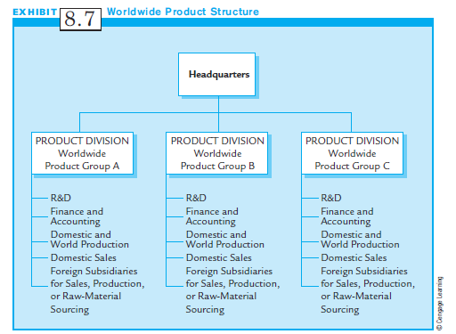
Exhibit 8.7:
Worldwide Product Structure

Slide 30
Hybrids
Both Worldwide Product Structure and Worldwide Geographic Structure have advantages and disadvantages:
  A Product Structure supports global products.
  A Geographic Structure emphasizes local adaptation.
Multinationals often want both abilities.
To achieve this, most multinationals use a Hybrid form of structure, which combines both.

Slide 31
Worldwide Matrix Structures (1 of 3)
To balance the benefits of geographic and product structures, and to coordinate their subunits, some multinationals create a Worldwide Matrix Structure:
  Unlike hybrids, it is a symmetrical organization with equal lines of authority for worldwide product groups and geographical divisions.
  The Geographic Divisions focus on national responsiveness.
  The Product Divisions focus on finding global efficiencies.

Slide 32
Worldwide Matrix Structures (2 of 3)
A Worldwide Matrix Structure:
  Balances the benefits produced by area and product structures
  Works best with near equal demands from both sides
  Requires extensive resources for communication and coordination
  Requires middle and upper level managers with good human relations skills
  In theory, produces quality decisions

Slide 33
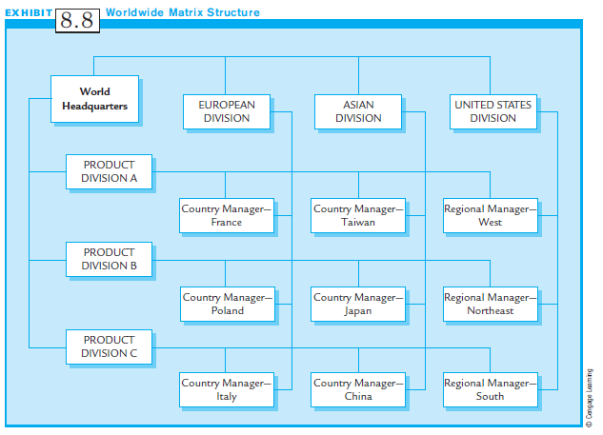
Exhibit 8.8:
Worldwide Matrix Structure

Slide 34
Worldwide Matrix Structures (3 of 3)
Problems with Worldwide Matrix Structures:
  Slow decision making process
  Too bureaucratic
  Too many meetings and too much conflict
Result:
  Some companies have abandoned their matrixes and returned to product structures.
  Others have redesigned their matrix structures to be more flexible with speedier decision making.

Slide 35
The Transnational Network Structure (1 of 3)
Unlike the symmetrical matrix structure, The Transnational Network has no basic form, symmetry or balance between geographic and product divisions.
Instead, The Transnational Network links different functional, product, and geographic subsidiaries dispersed worldwide.
Nodes, units at the center of the network, coordinate product, functional and geographic information.

Slide 36
The Transnational Network Structure (2 of 3)
No two subunits are alike.
Transnational units evolve to take advantage of resources, talent and market opportunities wherever they exist in the world.
Resources, people and ideas flow in all directions.

Slide 37
Transnational Network Structures: An Example (1 of 2)
The Dutch multinational Philips Electronics N.V. works in 60 different countries, making products as diverse as defense systems and light bulbs.
Philips has 8 product divisions with more than 60 subgroups based on product similarity.
The product divisions have subsidiaries, which may focus on only one product or on an array of products.
Subsidiaries can specialize in R&D, sales, etc.
Some units are highly independent, some tightly controlled.

Slide 38
Transnational Network Structures: An Example (2 of 2)
Philips divides the world into three groups:
  Key countries such as the Netherlands and the United States produce for local and world markets, and control local sales
  Large countries such as Mexico and Belgium have some local and worldwide production facilities and local sales.
  Local business countries are smaller countries that are primarily sales units and that import products from the product divisions’ worldwide production centers in other countries.

Slide 39
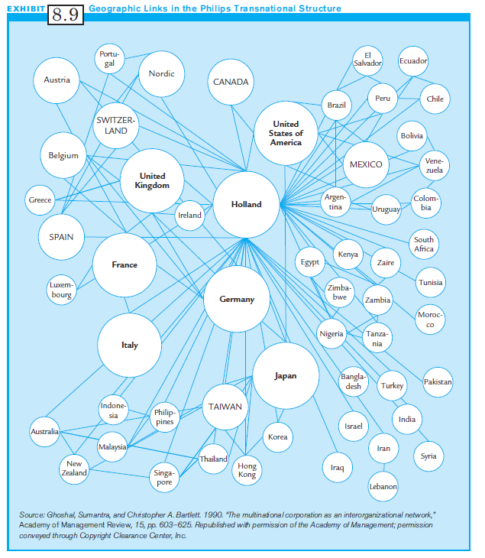
Exhibit 8.9:
Geographic Links in the Philips Transnational Structure

Slide 40
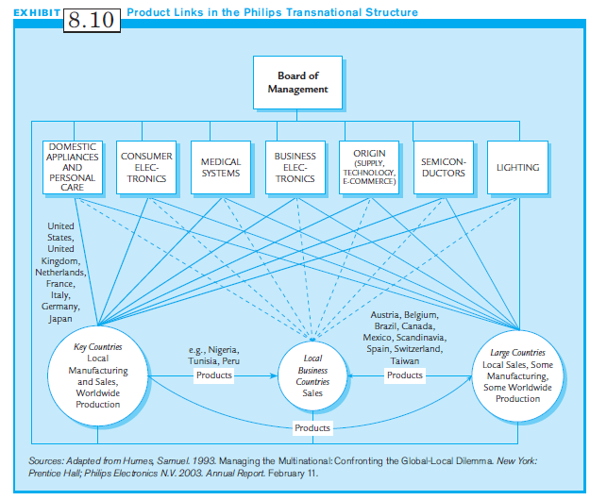
Exhibit 8.10:
Product Links in the Philips Transnational Structure

Slide 41
The Transnational Network Structure (3 of 3)
The basic structural framework of The Transnational Network has 3 components:
  Dispersed subunits are subsidiaries located anywhere in the world they may benefit the firm.
  Specialized Operations are subunits that specialize, whether in product lines, research or marketing.
  Interdependent Relationships must exist to manage the dispersed and specialized subunits which share resources and information continuously.

Slide 42
Metanational Structure
Large entrepreneurial multinational
  Can tap into pockets of innovation, technology, and markets located around the world
An evolution of the transnational network structure that develops extensive systems to encourage organizational learning and entrepreneurial activities

Slide 43
Beyond the Transnational:
The Metanational? (1 of 2)
Structure for multinational firms continues to evolve.
A new structure is emerging called The Metanational, a large, entrepreneurial multinational firm able to tap into hidden pockets of innovation, technology and markets, especially emerging markets worldwide.
The Metanational is similar to the Transnational:
  It is a networked, but centerless organization
  Decision-making resides with the subunits.

Slide 44
Beyond the Transnational:
The Metanational? (2 of 2)
The Metanational is different from the Transnational in that:
  It has an overriding objective to learn from anywhere in the world, and to share that knowledge with everyone in the company.
  The Metanational organization uses the latest in virtual connectivity to link team members worldwide.

Slide 45
Characteristics of Metanationals (1 of 2)
The characteristics of the Metanational structure are:
  Nonstandard business formulas for any local activity
  Looking to emerging markets as sources of knowledge and ideas, not just for local labor
  Creating a culture and advanced communication system that supporting global learning
  Extensive use of strategic alliances to gain knowledge for varied sources

Slide 46
Characteristics of Metanationals (2 of 2)
The characteristics of the Metanational structure (cont’d):
  High levels of trust between partners to encourage knowledge sharing
  A centerless structure that moves strategic functions away from headquarters and to major markets
  A decentralization of decision making to managers who serve key customers and strategic partners

Slide 47
Multinational Strategy and Structure: An Overview
Most companies support early internationalization efforts with export departments.
Depending on globalization strategy, they evolve into product or geographic structure.
Pressures for local adaptation and global efficiencies move to matrix or transnational network structures.
Most companies never quite reach a pure structure, and instead, adopt a hybrid structure.

Slide 48
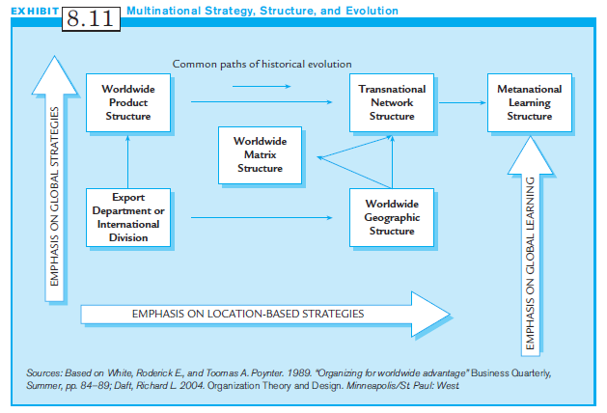
Exhibit 8.11:
Multinational Strategy, Structure, and Evolution

Slide 49
Control and
Coordination Systems (1 of 2)
Although different subunits perform specialized tasks, managers must design organizational systems to control and coordinate their activities.
Control Systems help link the organization vertically, up and down the organizational hierarchy in two ways:
  They measure or monitor performance of the subunits
  They provide feedback on effectiveness to subunit managers

Slide 50
Control and
Coordination Systems (2 of 2)
Coordination Systems link the organization horizontally.
  Coordination Systems provide information flows among subsidiaries so that they can coordinate their activities.
  Example: Ford plans to use advanced information systems so that designers in Europe, the U.S. and Japan can coordinate their design efforts for the world market.

Slide 51
Design Options for
Control Systems
There are four broad types of control systems:
  1. Output control systems
  2. Bureaucratic control systems
  3. Decision-making control systems
  4. Cultural control systems

Slide 52
Output Control Systems
1. Output Control Systems:
    Assesses the performance of a unit based on results, not on the process used to achieve those results
    Responsibility for profit is the most common output control.
    Example: a Profit Center.

Slide 53
Bureaucratic Control Systems;
Decision-Making Control Systems
2. Bureaucratic Control Systems:
    Focuses on managing behaviors, not outcome
    Examples include budgets, statistical reports, and centralization of decision-making.
    Budgets set financial targets for expenditures.
    Statistical reports provide information to top management on non-financial outcomes.
    Standard operating procedures (SOPs) provide rules that identify approved ways of behaving.

Slide 54
Bureaucratic Control Systems;
Decision-Making Control Systems
3. Decision-making Control Systems:
    The level of the organization where managers have the authority to make decisions.
    In decentralized organizations, lower-level managers make many important decisions.
    In centralized organizations, higher-level managers make most important decisions.
    Transnational structures do not have a tendency for control in either direction.

Slide 55
Cultural Control Systems
4. Cultural Control Systems:
  Use organizational culture to control employees’ behaviors and attitudes
  Strong organizational cultures develop shared norms, values, believes and traditions
  Such cultures encourage high levels of commitment and support for the organization.

Slide 56
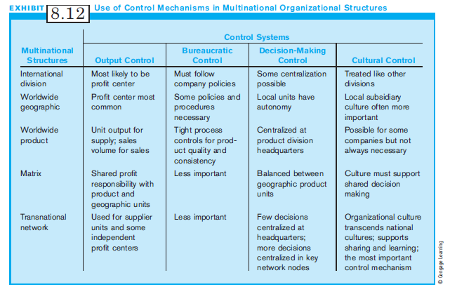
Exhibit 8.12:
Use of Control Mechanisms in Multinational Organizational Structures

Slide 57
Design Options for Coordination Systems
There are 6 basic horizontal coordination systems:
  Textual Communication: e-mail, memos, and reports
  Direct Contact: face-to-face interaction of employees
  Liaison Roles: part of a person’s job in one department to communicate with people in another department
  Task Forces: temporary teams created to solve a particular organizational problem
  Full-time Integrators: cross-unit coordination is the main job responsibility

Slide 58
Coordination Systems: Teams
Teams: (groups of employees working together)
  give companies the ability to better coordinate the work and expertise of widely dispersed individuals
  Develop and launch new products
  Become more flexible
  Are permanent units of the organization
  Are the strongest coordination mechanisms

Slide 59
Global Virtual Teams
Global Virtual Teams: groups of people from different parts of the world who work together by using information and communication technologies such as intranets, web meetings, WIKI’s, e-mails and instant messaging
Such teams face significant challenges due to diverse languages and cultural backgrounds located in different parts of the world.

Slide 60
How To Gain Effective
Global Virtual Teams
Steps a multinational can take to help global teams to function effectively:
  Build relationships and trust.
  Pay attention to project planning and hold project progress meetings regularly.
  Provide cultural, language, and active-listening training.

Slide 61
Knowledge Management (1 of 2)
Knowledge Management consists of the systems, mechanisms, and other design elements of an organization to ensure that the right form of knowledge is available to the right individual at the right time.
Managing knowledge can give multinational companies the means to create the global flexibility they will need to survive and prosper.

Slide 62
Knowledge Management (2 of 2)
To develop an effective knowledge management system:
  Identify potential barriers to knowledge sharing within the organization.
  Assess the degree to which these barriers exist and implement action to reduce their effects.
The organizational structure should be aligned with the need for knowledge management.

Slide 63
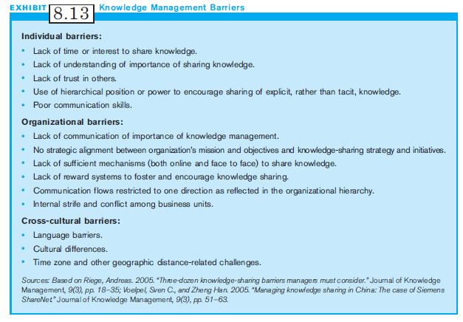
Exhibit 8.13:
Knowledge Management Barriers

Slide 64
Summary
Good strategies do not guarantee success. The MNC also needs a good organizational structure to achieve its goals.
The MNC needs the right organizational design to carry out its strategic intent, goals and objectives.
We reviewed basic organizational structures and discusses international organizational designs and structures.
We also discusses knowledge management systems.

